Slide 1

What makes the perfect yarn?
Mining data from Ravelry.com
By Alex Hall

Slide 2
What is Yarn and what is Ravelry?
Not to be confused with Apache YARN!
According to Wikipedia it is a ‘long continuous length of interlocked fibers’.
To most, it is known colloquially as a ‘ball of wool’.
Ravelry is often described as ‘the facebook of knitting’.
Amongst many other things, contains a database of yarns, along with user ratings – these are notoriously difficult to predict.
The database was accessed via an API key, to compose a dataframe of all yarns

Slide 3
Processing the raw data and reducing dimensionality
The dataset required significant processing to remove list type objects and make all attributes numeric.
Fiber type data was particularly difficult to process. The embedded lists were converted into individual attributes representing the % of each fiber type in each yarn instance.
3 new attributes were also created from the fiber_type data.
The rating_average attribute is the dependant variable. Ie a regression problem

Slide 4
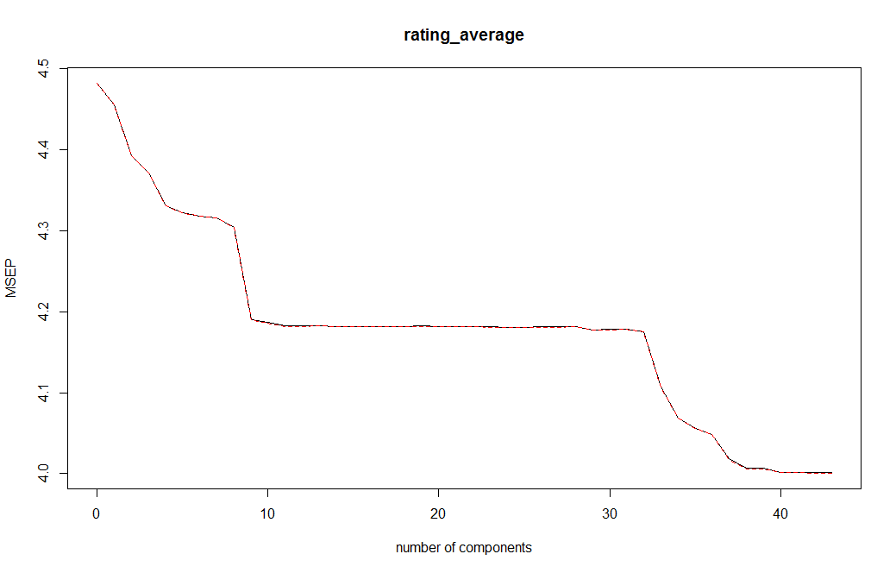
Dimensionality reduction
With all attributes in numeric form, many could be deleted:
It was decided not to analyse text-type attributes in this study.
Many attributes were trivially-dependant and so could be removed.
Principle component analysis was then carried out to identify any remaining redundant variables.
Since none were identified, all remaining variables were carried forward – giving 44 in total.

Slide 5
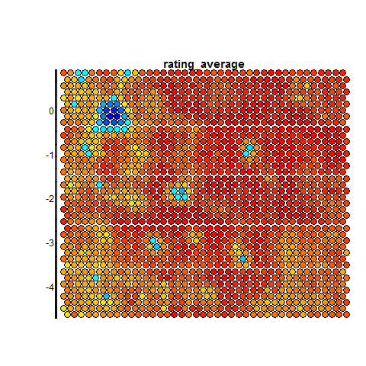
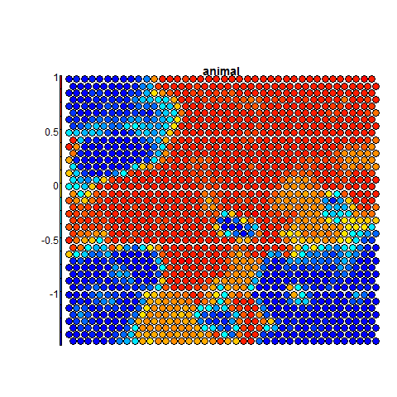
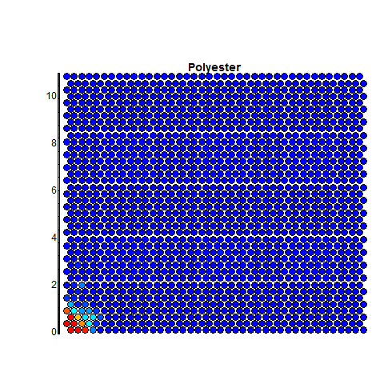
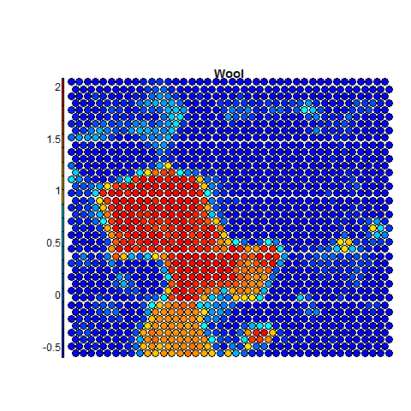
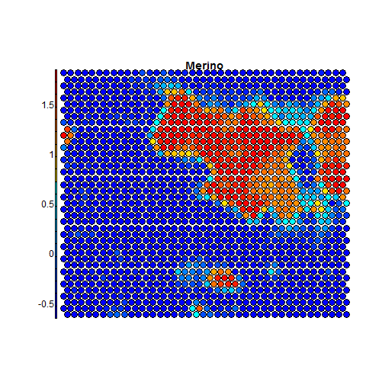
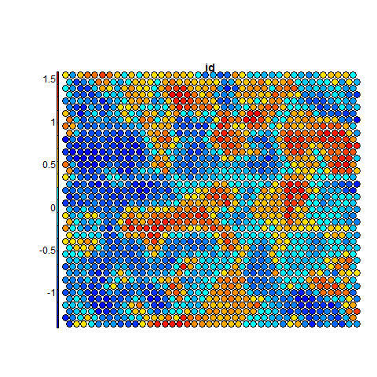
Data exploration with a SOM

Slide 6
Analysis
3 methods were used:
Support Vector Machine, with ‘cost’ and ‘gamma’ parameters tuned.
Random Forest with ‘mtry’ and ‘nodesize’ parameters tuned.
Deep Neural Network with random search on depth, number of nodes and several parameters.
The Random Forest method outperformed all others, even prior to parameter tuning.

Slide 7
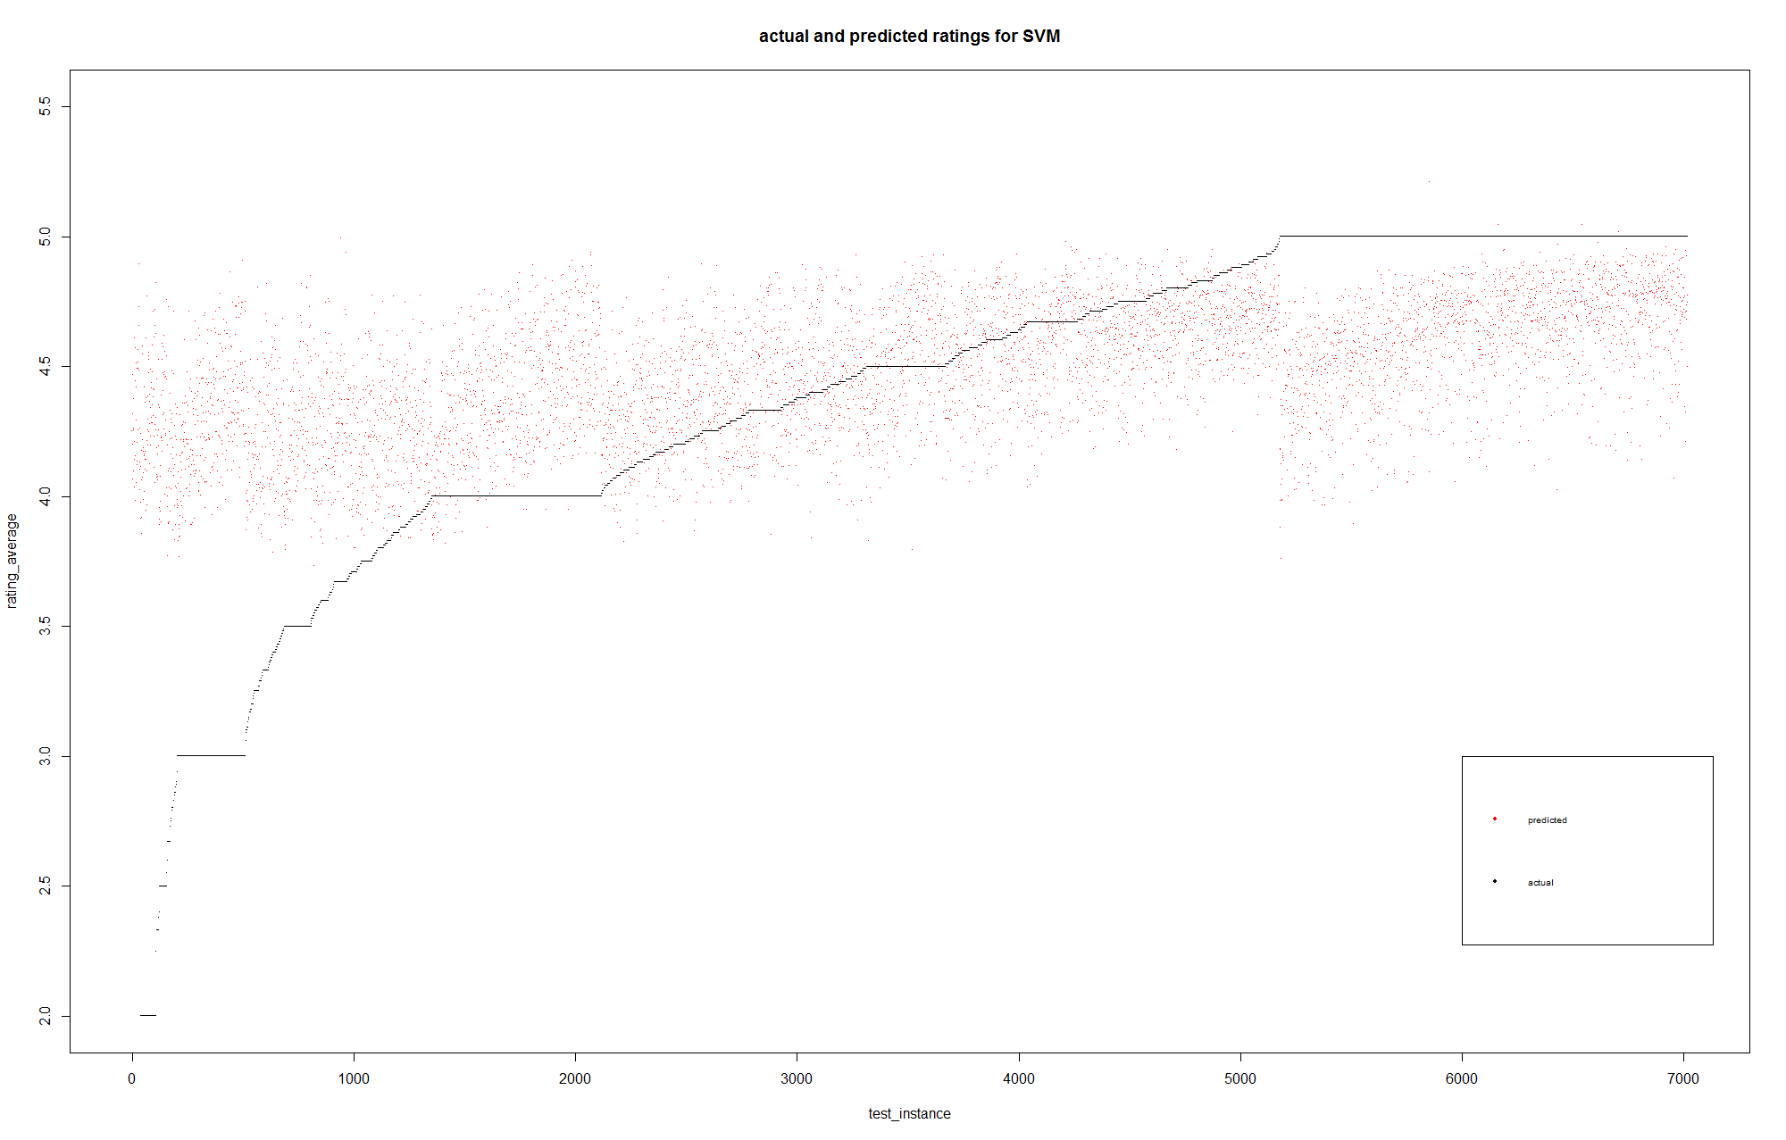
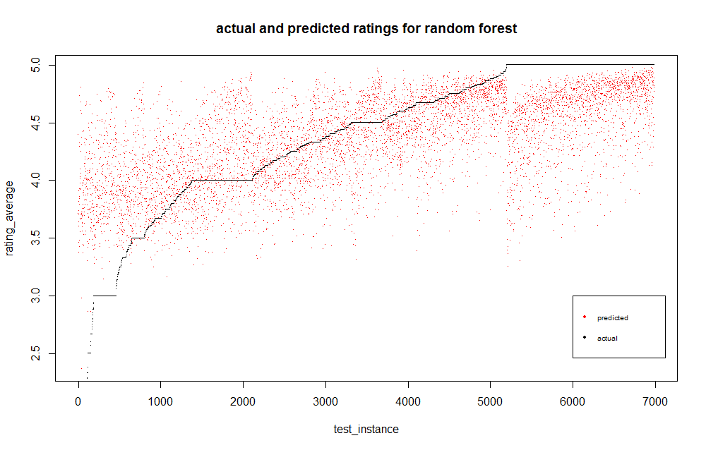
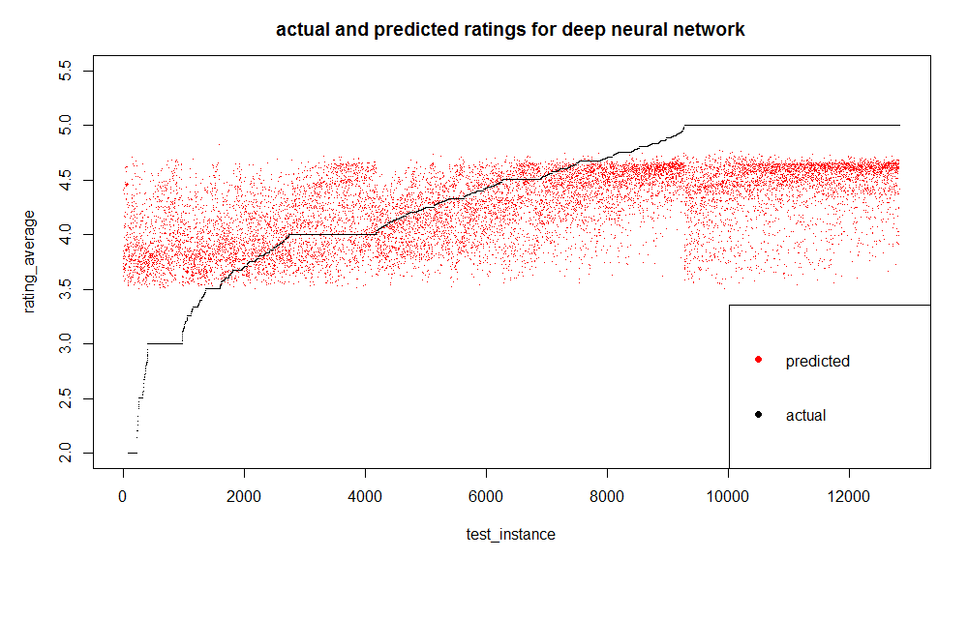
Results
RMSE = 0.584
RMSE = 0.551
RMSE = 0.584
Benchmark RMSE = 0.675

Slide 8
Parallelisation
With 44 attributes and over 100,000 instances, a single SVM required 4 hours to run on a single core of an AMD A8.
In order to tune parameters and perform cross validation, at least 80 experiments were required, giving a predicted runtime of 4*80 = 320 hours.
The ‘DoParallel’ library was used to parallelise the code. However, this was still not sufficient.
Amazon EC2 was used for all experiments, with the c4.8x instance used (36-core Intel Xeon processor).
Spot pricing was applied, with an average cost of $0.40/hr.
The random Forest experiment required 3hrs and the SVM required 4hrs.
Neural networks did not require parallelised code since they are inherently parallelised by their respective packages.

